Slide 1

Demand Model:
Marketing Mix Model
An Introduction

Slide 2
Agenda
What do we and don’t we mean by Demand Model?
What are they used for?
What are the common types of Demand Models?
What are typical Regression-Based Demand Models?
How are they built?
Why is it complicated?
What is a good model and what are the “dos” and “don'ts” of building one?

Slide 3
Agenda
What do we and don’t we mean by Demand Model?
What are they used for?
What are the common types of Demand Models?
What are typical Regression-Based Demand Models?
How are they built?
Why is it complicated?
What is a good model and what are the “dos” and “don'ts” of building one?

Slide 4
Demand Models (a.k.a Market Response Model, Marketing Mix Model)
[Analytical] “device” that estimates sales (volume, revenue) as a function of marketing activity and other variables describing the state of the market
Distribution
Price
Promotions
Advertising
PR
Competitors’ activity
Seasonality, Trend
Weather
Economic indicators
…
Demand
Model
Sales
Parameterized set of rules
Parameterized set of equations
Parameterized simulation
Group of analysts / consultants
Set of Spreadsheets

Slide 5
Transactional / individual Consumer-Based Analyses: Observed Behavior
Market Basket Analysis
Which items are complements (often bought together)
Cross-sell opportunities
Which items are substitutes (exchangeable)
Up-sell opportunities
Assortment planning
Purchase frequency, repurchase rates
Life-time value of customers
Promotion frequency / flighting / pulsing
Consumer Panel Analysis
Channel switching
Share of wallet

Slide 6
Consumer-Based Analysis: Stated Intent
Surveys, focus groups
NPI: Purchase intent
Copy scores: recall, persuasion, stickiness,…
Conjoint analysis
Impact of product attributes on purchase intent

Slide 7
Agenda
What do we and don’t we mean by Demand Model?
What are they used for?
What are the common types of Demand Models?
What are typical Regression-Based Demand Models?
How are they built?
Why is it complicated?
What is a good model and what are the “dos” and “don'ts” of building one?

Slide 8
What is it good for?
Measuring the contribution of activities to sales: Disentangling of the effects of activities happening simultaneously
Volume Contribution from activity
Translates into ROI
Explaining volume differences over time
Enhance understanding of the marketplace
Measuring the impact of an activity
Price elasticity, promo lift, strength of competitor’s impact

Slide 9
What is it good for?
Predict sales for any marketing plan
Scenario analysis, War gaming, Sales forecasting
Comparison of different plans based on their expected sales contributions by activity and/or P&L impact
Decision support through optimization
Monitoring of changes in the marketplace
Does my old model still agree with current data?
How do models calibrated on new and old data differ?
What does that say about the effectiveness of my activities?

Slide 10
Measuring the impact of marketing & trade activities: Experiments vs. Observations
Experiments: isolate the impact of a single activity and compare “with” and “without” (treatment vs. control group, clinical trial paradigm)
Can be very accurate to assess single activity
Is expensive and often infeasible
Does not allow for interaction between activities
Observations: Analyze historical data to attribute impact to activities
Can capture many more activities as well as environmental effects
Can capture many interactions between activities
Does not interfere with business
Is relatively cheap
Is less sensitive
Requires a model to disentangle the effects of many simultaneous activities and factors

Slide 11
Agenda
What do we and don’t we mean by Demand Model?
What are they used for?
What are the common types of Demand Models?
What are typical Regression-Based Demand Models?
How are they built?
Why is it complicated?
What is a good model and what are the “dos” and “don'ts” of building one?

Slide 12
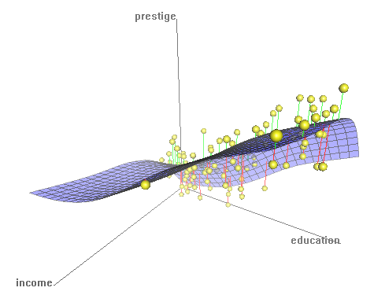


Market Response Models:
Modeling Techniques
Regression-based
A set of equations
Agent-based
A simulation of a population of actors
Pattern Recognition based
A general purpose filter

Slide 13

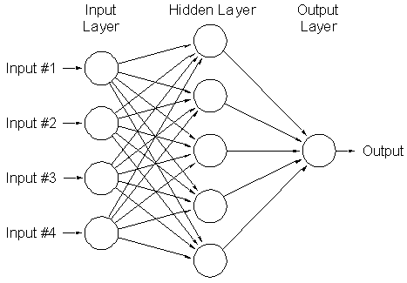
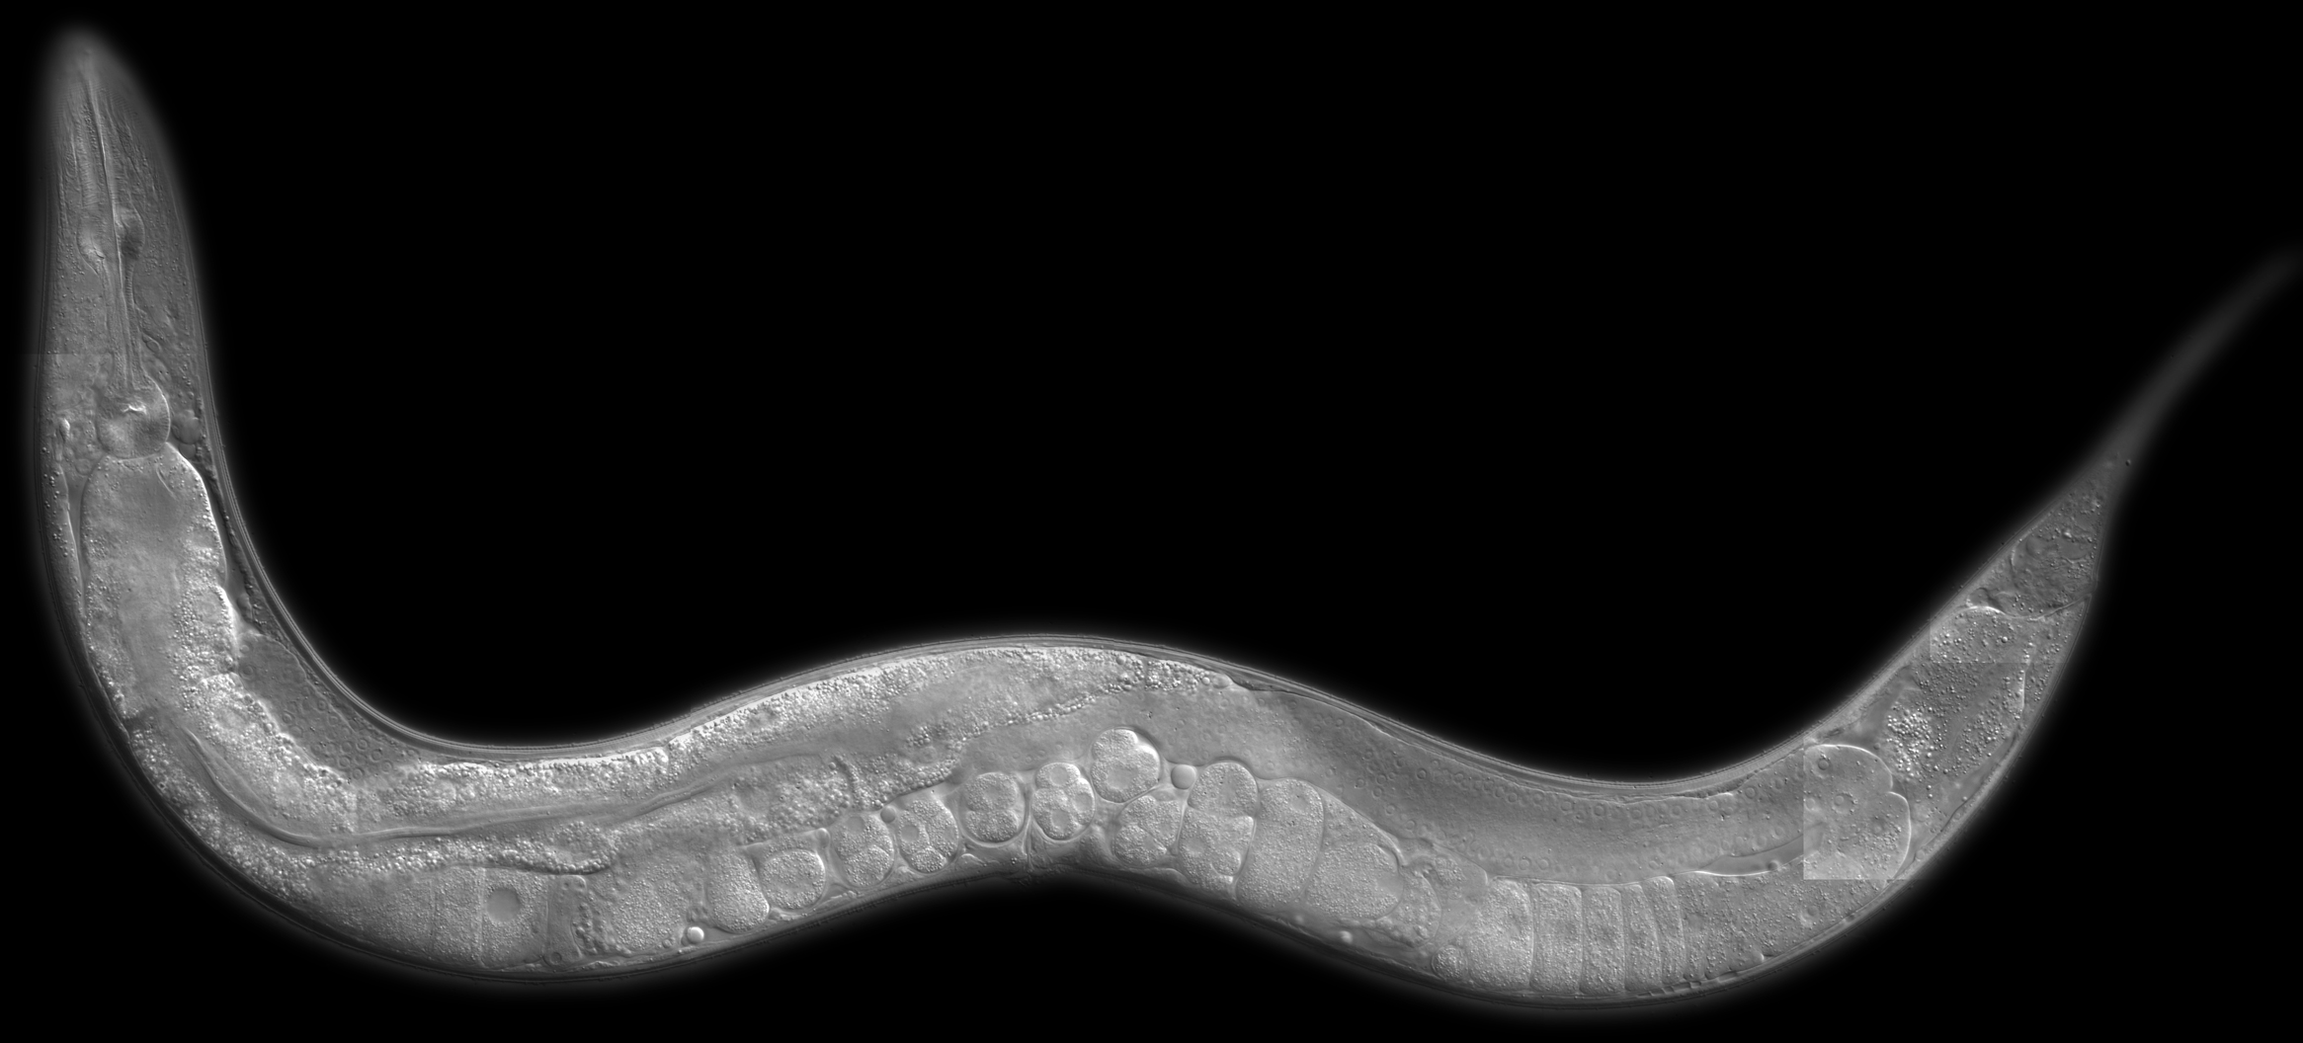
Market Response Models:
Pattern Recognition-Based Models
Description:
Abstract data structures (neural networks resembling a very simplified version of the brain) are trained on historical data to reproduce historical response pattern which are then used to predict responses to new scenarios
Based on distrust of “mental models” of the market
Results not “tainted” by intuition
Can only recognize simple pattern, Models limited to very few input variables
Models not interpretable
Cool to geeks
Notes:
c. Elegance
302 neurons

Slide 14
Market Response Models:
Agent-Based Models
Description:
Individual decision makers’ (consumers, groups of consumers) response to marketing and environmental factors (as well as each other) are parameterized and computer simulations of interactions of these agents are run and market outcomes are observed. Individual agents are calibrated to fit historical market behavior
Calibration is very hard
These models usually account for a limited number of isolated activities
Execution is very computationally expensive
Good for qualitative results on new activities that show very non-linear effects (e.g., social media)
Emergent behavior
Dynamic effects (tipping points)
Sexy and en vogue

Slide 15
Market Response Models:
Regression-Based Models
Description:
A parameterized functional form is specified and parameters are estimated from historical data resulting in an explicit equation that calculates the business metric from explanatory variables
Techniques differ by what functional form is used and how coefficients are estimated: OLS, GLS, Hierarchical Bayesian, Mixed Effect Models, MCMC, Constraint Quadratic Optimization, logistic regression, CART, …
Most common approach
Can handle many diverse effects in the same model
Describes aggregate-level sales as a function of aggregate-level inputs
Requires an understanding how activity affects sales in the aggregate
Provides good qualitative and quantitative results.

Slide 16
Agenda
What do we and don’t we mean by Demand Model?
What are they used for?
What are the common types of Demand Models?
What are typical Regression-Based Demand Models?
How are they built?
Why is it complicated?
What is a good model and what are the “dos” and “don'ts” of building one?

Slide 17
Typical Model Forms for Multivariate Regression-Based Demand Models
Choice of model form depends on
Mental model of how activities affect volume in the specific business
Nature of business questions to be supported
Data availability
Estimation technique to be employed
Additive:
Pros:
Easy to estimate
Easy to analyze/decompose
Cons:
Require careful normalization
Have a relatively small validity range
Don’t capture base volume changes well (including distribution effects)

Slide 18
Typical Model Forms for Multivariate Regression-Based Demand Models
Choice of model form depends on
Mental model of how activities affect volume in the specific business
Nature of business questions to be supported
Data availability
Estimation technique to be employed
Multiplicative:
Pros:
Typically larger relevant range
Capture some interactions of activities implicitly
Cons:
May create counterintuitive interactions
Note: to capture distribution effects better, models are often built to predict Sales Velocity (=Volume per point of %ACV) rather than volume. Volume models are then obtained by multiplying Sales Velocity by %ACV.

Slide 19
Activity Measure Transformations
Activity measures sometimes do not correlate highly with consumer behavior because:
Behavioral change may not be proportionate to activity measure
Diminishing returns ▪ Critical mass
The changed behavior might not happen at the same time as the activity
Memory effects ▪ Redemption delays
These effects are captured by pre-transforming the activity time series
Decay and saturation of Media measures
Application of redemption profiles to coupons
Many others

Slide 20
Agenda
What do we and don’t we mean by Demand Model?
What are they used for?
What are the common types of Demand Models?
What are typical Regression-Based Demand Models?
How are they built?
Why is it complicated?
What is a good model and what are the “dos” and “don'ts” of building one?

Slide 21
Estimating Demand Models
%Merch=60
Price=$2.70
TV=50
%Merch=70
Price=$2.60
TV=20
%Merch=30
Price=$3.50
TV=0
%Merch=0
Price=$4.10
TV=200
%Merch=0
Price=$4.20
TV=0
%Merch=20
Price=$3.80
TV=50
%Merch=20
Price=$3.70
TV=0
Need to find values that give “good fit”
Model Form
Known for the past

Slide 22
Estimating Demand Models: How to use Math to find a Model
Establish a criterion for what a good model is, given the observed sample data
Sum of squared errors:
Sum of absolute errors:
Likelihood of coefficients:

Slide 23
Estimating Demand Models: How to use Math to find a Model
Find a vector of coefficients optimizes the chosen criterion:
Minimize SSE Ordinary Least Square (OLS) Regression
Minimize SAE Least Absolute Deviations (LAD) Regression
Maximize Likelihood Maximum Likelihood (ML) Regression
Regression is an optimization problem for the coefficients of the model with an objective function that depends on the observed data

Slide 24
Estimating Demand Models:
A Candidate Model
Actual Volume=2028
Predicted Volume=1670

Slide 25
Estimating Demand Models:
Another Candidate Model

Slide 26
Estimating Demand Models:
Another Candidate Model

Slide 27
Estimating Demand Models:
Another Candidate Model

Slide 28
Estimating Demand Models:
The Optimal Model

Slide 29
Agenda
What do we and don’t we mean by Demand Model?
What are they used for?
What are the common types of Demand Models?
What are typical Regression-Based Demand Models?
How are they built?
Why is it complicated?
What is a good model and what are the “dos” and “don'ts” of building one?

Slide 30
The Need for Structure
Typical Marketing Mix example:
#Products: 100 ▪ #Locations 100 ▪ #Variables in each model: 52
#observations for each product/location combination: 104
Ratio of #observations (100x100x104) to independent coefficients (100x100x52) of two leads to severely over-fit models
Need to impose a structure on the coefficient set to reduce number of independently estimated coefficients:
Pooling coefficients: Coefficients to be the same across subsets of Prod/Loc combos
Shrinking coefficients: Coefficients to be similar (for some difficult to explain definition of “similar”) across subsets of Prod/Loc combinations
Grouping variables: Coefficients to be the same for a subset of variables

Slide 31
Incorporating Prior Information
Often, the dataset at hand contains all the information that is available and needed to create an accurate demand model
Most organizations have access to prior information that was distilled from other data sources and should be incorporated into demand models
Bayesian Estimation techniques are the best understood and most consistent tools to incorporate that information.
Posterior
Distribution
“Data” Distribution
Prior Distribution

Slide 32
Agenda
What do we and don’t we mean by Demand Model?
What are they used for?
What are the common types of Demand Models?
What are typical Regression-Based Demand Models?
How are they built?
Why is it complicated?
What is a good model and what are the “dos” and “don'ts” of building one?

Slide 33
The Elements of Demand Modeling
Model Scope
Products, channels, activities/effects
Model Form
Structural assumptions of how activities affect volume
Model structure
Plan-able measures
Transformations
Derived from an understanding of the process that generated the data
Qualitative and directional impact of activities and environment on consumer behavior
Assumptions on coefficient set
Granularity and similarity of coefficients across products, locations, time and activities

Slide 34
The Elements of Demand Modeling
Business knowledge and intuition
Prior information on coefficient sign and ranges
Statistical estimation
Estimation techniques need to support the structure outlined above
Model quality assurance
Predictiveness, consistency
Interpretation and Analysis
Insights, scenario analysis, optimization, tracking

Slide 35
Hallmarks of a good Predictive Model
Understood and justified model form and transformations
Internal consistency of modeled effects
Internal consistency of coefficients
Sufficient coverage of products and channels
Sufficient coverage of activities and external factors

Slide 36
Hallmarks of a good Predictive Model
Consistency with intuition and prior business knowledge
Meaningful interpretable coefficients
Right level of aggregation
High expressiveness but low degrees of freedom
Statistical significance of coefficients

Slide 37
Bad Things Modelers Do
Use the wrong model structure
Does volume respond intuitively across a wide range of inputs?
Let the data choose the model structure
Ratio of observations to degrees of freedom in MMM to low to do that
Rely on cleaning up the model after estimation rather than specifying structural constraints up front
Leads to Swiss cheese models and overestimation of effects
Drop activities from the analysis because of high correlation
Leads to miss-attribution of effects to the remaining variables and interferes with planning
Put in too many effects and “see what sticks”
Often done for cross effects, leads to overfitting and inconsistent sets of effects across products and locations
Beautify models with dummy variables
Particularly detrimental and
exposed if models are used for
planning and scenario analysis

Slide 38
Transparency in Demand Modeling
While the model is NOT the deliverable, clients are aware of the central role it plays in the analysis and want to understand it
Quality of demand models strongly depends on the validity of the assumptions made in the modeling process
Assumptions need to be derived from an understanding of the business and validated with the client
The client owns the models, we need to explain the modeling choices and act on their input
Clients should be involved in the modeling process as much as they want
Models need to be monitored over time and updated as needed

Slide 39
Measurement vs. Panning
Demand models have traditionally been used to measure the impact of marketing activity on sales
Marketing Mix Studies
Increasingly, they are used as a planning and optimization tool
Requires full coverage of all relevant marketing activities
For that reason, incorporation of information about activities whose impact cannot be measured from the dataset at hand is becoming more important:
Intuition
Industry averages
Other studies
The result is an increased use of Bayesian Methods
Side effect: including these unmeasured effects improves accuracy of the measurements

Slide 40
Marketing Mix Model:
FMCG Case Study
Analytic Edge Proprietary and Confidential

Slide 41
Measurement vs. Panning
The primary goal of MMM is to identify and quantify the volumetric impact of each independent variable onto volume by related weekly changes in volume with respect to changes in the inputs.
Independent Variables*
Dependent Variable
Advertising
(TV, Print, Radio, OOH)
Trade Promotion
(Feature, Display,
Feat & Disp, TPR)
Weekly
Volume
Consumer Promotion
(FSCIs, Sampling)
Other Factors
(Price, Distribution,
Competition, PR,
Professional Efforts
/ Referrals)
* Independent Variables are also called: Predictors, Terms, or Vectors

Slide 42
Why do we use MMx Models?
Models allow us to isolate and quantify the impact of individual marketing tactics, in many cases even if they are executed simultaneously.
Analytic Edge Proprietary and Confidential

Slide 43
Sales Decomposition – Base & Incremental
Marketing incremental sales (about 25% of this example) would be lost immediately if marketing was pulled. Changes in incremental sales in the short-term can have an impact on Base sales in the long term.
Base
Base Price
Distribution
Competitive Impacts
Seasonality
Long-term impacts from marketing
Equity
Incremental
TV
Print
Radio
Trade
PR
Other Marketing
Trade
Base
Sales
TV
FSI
Print
Analytic Edge Proprietary and Confidential

Slide 44
Case – Business Objective
Background:
CPG manufacturer has approximately 50 SKU’s in distribution, of which approximately 30 SKU’s make the “core” product group
Bulk of the advertisement budget is targeted towards “core”
Manufacturer has over the past year shifted a lot of marketing dollars from traditional media to digital media
Business Objective:
To quantify the impact of trade and media elements on core portfolio
To decompose total sales into base and incremental sales
To calculate the effectiveness and efficiency of media elements
To study if there is a difference in trade and media impact by channel
To identify if media budget should focus only on digital or a combination of traditional and digital media
Analytic Edge Proprietary and Confidential

Slide 45
Data Available
POS data – 104 weeks
Measures available are Sales, Price and Trade by channel
Media
TV – National level
Digital Video – National level
Digital Display - National level
Social Media - National level
Digital Search - National level
Mobile - National level
Radio – Market 1, Market 2 and Market 3
OOH – National, Market 1, Market 2 and Market 3.
Analytic Edge Proprietary and Confidential

Slide 46
Data Integration – Basic Tips
Data can be available from disparate sources and across multiple cross sections
Sales data can be at the national level
Media data can be at the regional level
To decompose the total sales into base and incremental, it is important to map disparate sources of data
GRP’s cannot be aggregated across geographies
Either get media data at the national level or have POS data at the regional level
Analytic Edge Proprietary and Confidential

Slide 47
Data Integration – Basic Tips
Based on project requirements, it is important to create a mapping file to ensure smooth data processing
State to region
State to city
City to location
Etc.
Population or proxy to size of the cross section is the preferred approach to mapping
Let’s say you have media data at the city level and POS at the state level
You need to map city to state and so having population of the city or proxy is key
You need to multiply the city population (%) with the city level GRP’s to build a correct model
Analytic Edge Proprietary and Confidential

Slide 48
Data Review Present data in a summarized format
Analytic Edge Proprietary and Confidential

Slide 49
Functional Form
Marketing Mix Models are typically built based on multiple linear regression (additive), and have the following general mathematical form:
Y_{t} = β₀ + Σβ_{κ} X_{kt} + ε_{t}
where:
Y_{t} = is the quantity of scanner volume or sales (estimate of the dependent variable)
β₀ = is the constant term (Y - intercept)
β_{k} = is the OLS regression coefficient for the k^{th} independent variable
X_{kt} = is the raw time series of the k^{th} independent variable at time t, or a transformation of the raw time series of the k^{th} independent variable at time t.
ε_{t} = is the model error or disturbance term
Analytic Edge Proprietary and Confidential

Slide 50
Cross Section
Separate models can be run for different outlets / channels to account for inherent differences
Models can be run for different cross sections as per requirement
Data for multiple channels can be obtained at the market or regional level so the models are pooled, meaning markets/regions are stacked and one model is built that spans all markets/regions
Analytic Edge Proprietary and Confidential
50

Slide 51
Pooled vs. National Models
Using a pooled-market approach takes advantage of the underlying commonality between markets by pooling markets together
Pooling the markets increases the number of data points substantially, allowing the use of more variables
The inherent differences in market size and geography can be accounted for by using a separate constant for each market
However, if the market level model fits are not good, the user is left with no choice but to try individual level models. Hence, it is important to gauge the amount of effort involved at the beginning of the project to avoid rework.
When building a pooled model, it is crucial to check model fits at the market level as well as the aggregate level in order to understand if assuming common response across markets is makes sense.
Analytic Edge Proprietary and Confidential
51

Slide 52
Market to Market Variation
Pooling markets together introduces Market to Market level variation into the model. In order to control for that, we use separate constant terms for each market.
Market to Market Variation
Single Market Model
Market 1
Market 2
Y_{t} = β₀ + Σβ_{κ} X_{kt} + ε_{t}
Week to Week Variation
Week 1
Week 1
Pooled Model
Y_{ht} = Σβ_{0n} + Σβ_{κ} X_{kt} + ε_{t}
Week 2
Week 2
Using separate constant terms is similar to running a model that looks at deviations from the mean:
Week 3
Week 3
(Y_{t}–Y_{m}) = Σβ_{κ} (X_{kt}–X_{km}) + (ε_{t}–ε_{m})
Analytic Edge Proprietary and Confidential

Slide 53
Using Separate Constants
While modeling without separate constants, the prediction does not fit any of the individual markets
Analytic Edge Proprietary and Confidential

Slide 54
Mean Centering – Bayesian Shrinkage
Mean centering is a more sophisticated approach towards building a pooled model. It is used widely to develop national level models using cross sectional time series data i.e. data available at city, region, state, etc. levels
Each variable is set equal to it’s value in the cross section-week data minus the cross section’s mean value for that variable
Assumes we are measuring the impact of changes over time within the same cross section and not differences across cross sections within the same week
PROC STANDARD in SAS can be used to mean center the data
PROC STANDARD DATA = LIBNAME.DATASETNAME MEAN = 0;
BY CROSS SECTION;
RUN;
Analytic Edge Proprietary and Confidential

Slide 55
Mean Centering – Bayesian Shrinkage
When we model, we want to understand the impact of changes in pricing or trade in a given cross section over time.
We don’t care why one channel sells more than another.
Mean-centering removes cross-channel differences. The average value of all variables becomes zero.
Analytic Edge Proprietary and Confidential
Notes:
Our models quantify the causes of sales being above or below the weekly average.

Slide 56
Variability
The model will generate a coefficient as long as there is any variation in the independent variable. But sometimes that variation is not meaningful and will not drive week to week changes volume sales
Some variation in price, but not enough to really drive volume change
In cases like above, the price term will only be picking up part of the intercept term.
Analytic Edge Proprietary and Confidential

Slide 57
Variability
Sometimes even if there is significant variation, that variation is still not meaningful
Price for a new product will be 0 before launch, use distribution for this not price
Price is 0 in markets where there are no sales in certain weeks causing dips
Analytic Edge Proprietary and Confidential

Slide 58
Correlations
Before modeling, check correlations between independent variables and volume.
PROC CORR DATA = LIBNAME.DATASETNAME;
VAR SELECT INDEPENDENT VARIABLES;
RUN;
Higher the correlation coefficient, more is the influence of the independent variable on dependent variable volume
If the variable is very important for the client and the correlation coefficient is counter intuitive, transformations usually come to rescue.
Analytic Edge Proprietary and Confidential

Slide 59
Modeling Base Price
Hypothesis:
Base Price has a negative relationship with sales
The price sensitivity of a brand can vary by cross section
Base Price Variable:
Smoothed base price per unit or volume
Non linear transformations can also be tested
Analytic Edge Proprietary and Confidential

Slide 60
Modeling Distribution
Hypothesis:
Both Distribution (presence of a brand in a store) and the Number of Items per Store (shelf set / variety) can positively impact sales
Distribution Variable:
Smoothed distribution term
Non linear transformations can also be tested.
Analytic Edge Proprietary and Confidential

Slide 61
Modeling Trade
Hypothesis:
Trade promotions have a positive impact on sales in the week of the activity
The impact of a promotion can depend on the vehicle, the %ACV coverage, and the depth of discount
Trade promotions may cause a negative impact on sales in future weeks (forward buying)
Trade Variables:
Separate variables are used for each type of promotion in order to account for differences in response
You can test the variables as is or transform using log
Promotion variables can be:
% ACV on Price Reduction
% ACV on Feature
% ACV on Display
% ACV on Feature and Display
Analytic Edge Proprietary and Confidential

Slide 62
Media Transformations
Hypothesis:
There is a positive relationship between sales and advertising for a brand
Advertising airing in week t impacts sales in that week and in future weeks, and the impact diminishes over time i.e. law of diminishing returns
Threshold and saturation levels of advertising exist in the marketplace
Media Variables:
TV – HH GRPs / Spend
Print – TRPs / Spend
Other – GRPs / Impressions / Clicks / Spend
Media variables are transformed into Ad-Stock using a retention rate (less than 100%) to account for this extended impact
Few industry ways to model media variables (in particular TV):
Log transformation
Ad-Stock
Exponential
Ad Bank
Analytic Edge Proprietary and Confidential

Slide 63
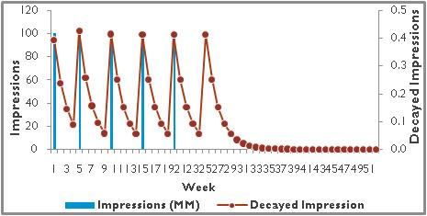
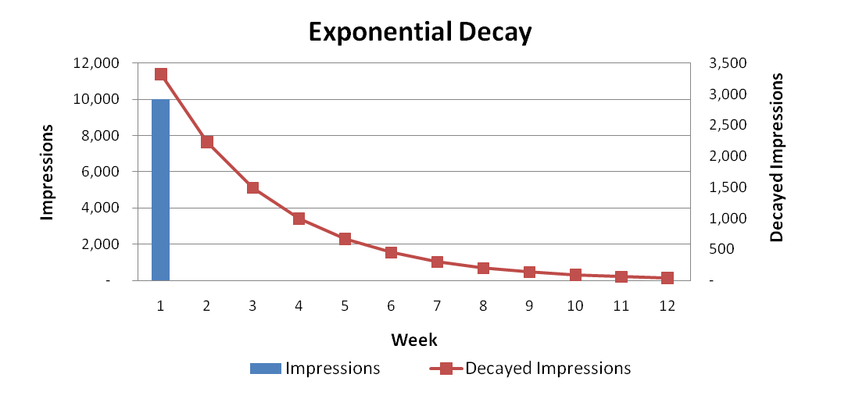
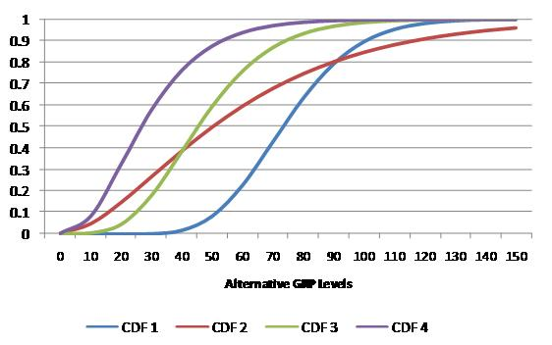
Media Transformations
Since MMM model is built using linear additive functional form, in order to capture non-linear relationship, marketing levers are transformed to align the lagged impact of the media delivery with it’s impact on consumer sales.
Ad-stock transformation:
Used with media activities likes TV, Print, Radio under the assumption that viewers who are exposed to media activity, to them advertisement awareness will decline exponentially over a period with diminishing returns i.e. Rate of change in media activity after certain level will give lesser rate of change in sales.
Exponential transformation:
Used with media activities likes TV, Print, Radio, Internet under the assumption that viewers who are exposed to media activity make purchases that decline exponentially within a specific period.
Ad-bank Transformation:
Used with media activities likes TV, Print, Radio, Online under the assumption that viewers who are exposed to media activity make purchases that decline exponentially or takes time to build and falls within a specific period. It is also known as Gamma distribution function and it incorporates diminishing return and identify minimum threshold of support.
Analytic Edge Proprietary and Confidential

Slide 64
Model Execution – SAS Code
Below is the SAS code used to run a MMx model:
PROC REG DATA = LIBNAME.DATASETNAME;
MODEL DEPVARS = INDEPENDENT VARS / VIF;
RUN;
“Reg” is the procedure in SAS used to run OLS model
Model specifies the equation of MMx
VIF is an option to detect multi-collinearity
Many options are available in SAS to run regression. Above code is what usually gets used unless there are specific challenges in the data
SAS online document is the best place to understand which options to use depending on user needs.
Analytic Edge Proprietary and Confidential

Slide 65
Model Results
R - the correlation coefficient between predicted and actual volume
R Square - the square of R, measures what percentage of variation is explained by the model. See ANOVA Table output for calculation
Adjusted R Square – Equal to:
1 - ((1 – R Square)(N - 1 )/ (N - k - 1))
where N is the number of data points and k is the number of independent variables. This adjusts the R square for the number of independent variables used - when the number of observations is small and the number of predictors is large, there will be a much greater difference between R-square and adjusted R-square.
Analytic Edge Proprietary and Confidential

Slide 66
Model Results
Durbin Watson - Measure of the correlation between successive error terms. Mathematically :
Analytic Edge Proprietary and Confidential
Notes:
SPSS does not differentiate between markets unless exclusively specified

Slide 67
The Durbin-Watson statistic ranges between 0 and 4, with a value of 2 indicating that there is no correlation. Low values indicate that the successive error terms are positively correlated:
Durbin- Watson = 0.5
High values indicate that the successive error terms are negatively correlated:
Durbin- Watson = 2.9
Acceptable values for the Durbin-Watson statistic are between 1.4 and 2.2
Analytic Edge Proprietary and Confidential

Slide 68
Sum of Squares:
Total: The difference between the actual values and dependent mean
Regression: The difference between predicted values and the dependent mean
This is the amount of explained variation
R-Square is calculated as SS Regression/SS Total
Residual: The difference between the actual and predicted values
This is the amount of unexplained variation – the goal of the regression algorithm is to minimize this value.
df (Degrees of Freedom) – the number of independent pieces of information available to calculate a parameter.
Regression: The number of independent variables in the model (not including the intercept)
Residual: Number of data points – number of independent variables – 1
Total: Regression df + Residual df = Total number of data points - 1
It’s always good to keep an eye on the Total degrees of freedom to make sure your model is running on the right number of data points.
Analytic Edge Proprietary and Confidential

Slide 69
Model Results
Mean Squares – Ratios of Sum of Squares and degrees of freedom
The Standard Error of the Estimate in the model summary table is the square root of the Mean Square Residual.
F & Sig. – The F statistic equals the Mean Square Regression / Mean Square residuals. The F test tests whether the coefficients for all of the independent variables are jointly equal to zero. If the Sig level is below the chosen threshold level then we can conclude that the regression coefficients are not all equal to zero.
The F test in a 1 variable linear regression model has the same significance level as the single coefficient, since both are testing whether that coefficient is equal to zero.
Analytic Edge Proprietary and Confidential

Slide 70
B – The unstandardized regression coefficient, which shows the change in volume for a one unit change in the independent variable, holding all other variables constant.
Std. Err – The uncertainty around the B coefficient.
Standardized Beta – The standardized regression coefficient, which answers the question of which predictors are more important in the model. Mathematically,
Standardized Coef X = Unstandardized Coef X * STD(X)/STD(Y)
This shows how volume changes for a one standard deviation change in X. So unlike the unstandardized coefficients, standardized coefficients can be compared across variables because they are no longer stated in terms of units.
Analytic Edge Proprietary and Confidential

Slide 71
Model Results
t/Sig – The t test statistic, calculated as the coefficient divided by the standard error, and its associated 2 tailed significance level. If this Sig. is less than a pre-selected level than the coefficient is considered to be statistically significant.
Tolerance/VIF – Measures of how correlated each independent variable is with every other independent variable in the model. The VIF is calculated as 1/(1-Rsquare_{i}) where R-Square_{i} is the R-Square that would be obtained by modeling variable_{i} as a function of every other independent variable in the model. Tolerance is simply 1/VIF, so the higher the VIF or the lower the Tolerance, the more correlated a variable is with other predictors. The square root of VIF shows how much larger the standard error is compared to what it would be if that variable was un-correleated with other predictors.
Analytic Edge Proprietary and Confidential

Slide 72
Model Reporting

Slide 73
Volume Decomposition –
Model with Constants
Volume decomposition translates coefficients from the model and execution levels from the data into volume streams
At the end of the volume decomposition procedure, you will know how much volume is being driven by every variable in each time series and cross section
In an un-pooled model, volume from the intercept is the intercept itself
In a pooled model with constants, we will have a different intercept for every cross section. In that case:
Calculate the total intercept for each cross section i.e. sum of the overall intercept plus the cross section dummy
Decomposed intercept is then calculated as the sum of each of the individual cross section intercepts.
Analytic Edge Proprietary and Confidential

Slide 74
Volume Decomposition –
Mean Centering
In a pooled model using mean centering, the fixed effects model i.e. the national level model is decomposed the same way
However, once you calculate the predicted volume, you need to add the weekly mean back to the calculated predicted volume
To get random effects model i.e. to drill down from the national level model to the cross section level model, you need to use PROC MIXED in SAS
PROC MIXED DATA = LIBNAME.DATASETNAME;
CLASS CROSS SECTION;
MODEL DEPVAR = INDEPENDENT VARS / SOLUTION;
RANDOM INDEPENDENT VARS / SUBJECT = CROSS SECTION SOLUTION;
RUN;
Random keyword in SAS generates random effect coefficients for each level of cross section. You can choose variables of interest to randomize
Total effect for that cross section will be fixed effect + random effect
Analytic Edge Proprietary and Confidential

Slide 75
Volume Decomposition –
Mean Centering
For larger samples, coefficients you get by running PROC REG will be exactly similar to coefficients generated using PROC MIXED
In large samples, OLS is similar to MLE method of parameter estimation
Example to calculate random effect coefficient
Let’s say you want to see the impact of TV across different states
You have built a national level model using mean centering approach
You have calculated the impact of TV at the national level. Now you want to see the impact of TV for each state
Use the below PROC MIXED code:
PROC MIXED DATA = LIBNAME.DATASETNAME;
CLASS STATE;
MODEL DEPVAR = INDEPENDENT VARS / SOLUTION;
RANDOM TV / SUBJECT = STATE SOLUTION;
RUN;
Analytic Edge Proprietary and Confidential

Slide 76
Volume Decomposition –
Mean Centering
If you have 3 states viz. Karnataka, Maharashtra and Haryana, then using the PROC MIXED code, you will get 3 coefficients for TV; one for each state
You need to add this random coefficient to the coefficient for TV obtained using PROC MIXED code without the random keyword. This will be the final random effect coefficient for TV for each state
You can now divide the data by these 3 states and calculate the volume decomposition using the logic we discussed before
Analytic Edge Proprietary and Confidential

Slide 77
Model Fit - Sample
Comments
Analytic Edge Proprietary and Confidential

Slide 78
Volume Contribution
Overall (Aug’09 – Jul’11)
Previous Year (Aug’09 – Jul’10)
Current Year (Aug’10 – Jul’11)
Base
Incremental
Base
Incremental
Base
Incremental
66%
34%
64%
36%
68%
32%
Incremental volume includes contribution due to all the Above the line (ATL)media spend where as base constitutes of contributions due to all other factors
TV is the biggest contributor to incremental volume
Very high spend in OOH shows high contribution in current year compared to previous year
Analytic Edge Proprietary and Confidential

Slide 79
Volume Change – High Level
Incremental unit sales due to OOH and Radio in the current year is higher compared to previous year
Volume contribution due to all other ATL media show drop in current year compared to previous year
Analytic Edge Proprietary and Confidential

Slide 80
Media Effectiveness
Significant Model Parameters
Effectiveness
Media Contribution
Effectiveness: Volume Per $1000 media spend
Comments
Analytic Edge Proprietary and Confidential

Slide 81
THANK YOU

